Slide 1
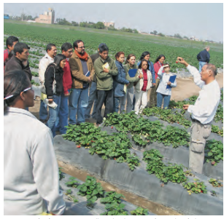
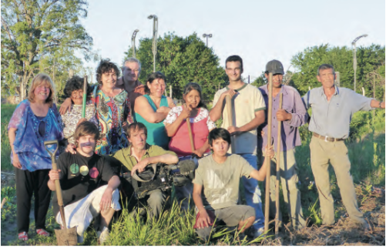
Agroecology, food and nutrition security
Caterina Batello FAO
Roma 23 Maggio 2017
CIA – Anabio

Slide 3
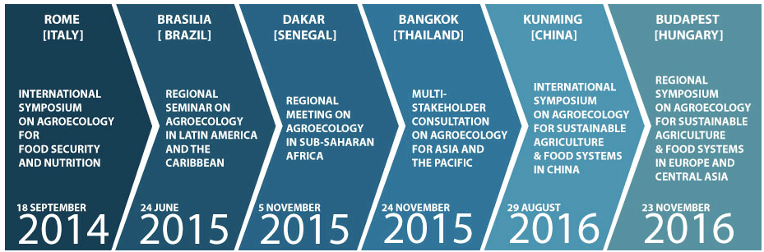
Why agroecology in FAO?
Necessary transition to sustainable food systems, producing more socio-economic benefits with less environmental and social costs (SDG 1, 2, 15)
FAO’s ROLE: inter-sectorial dialogue to gather & exchange knowledge of:
  agroecological science
  good practices and field experiences
  legal frameworks and public policies

Slide 6




What makes agroecology different from other sustainable agricultural approaches?
As an integrated approach, it addresses 3 dimensions of sustainability, putting the farmers and the social actors at the center of the food system.
4 of 10 AE elements of FAO focus on social dimension
Co-creation of knowledge
Human and social value
Culture and food traditions
Land and Natural Resources governance

Slide 7
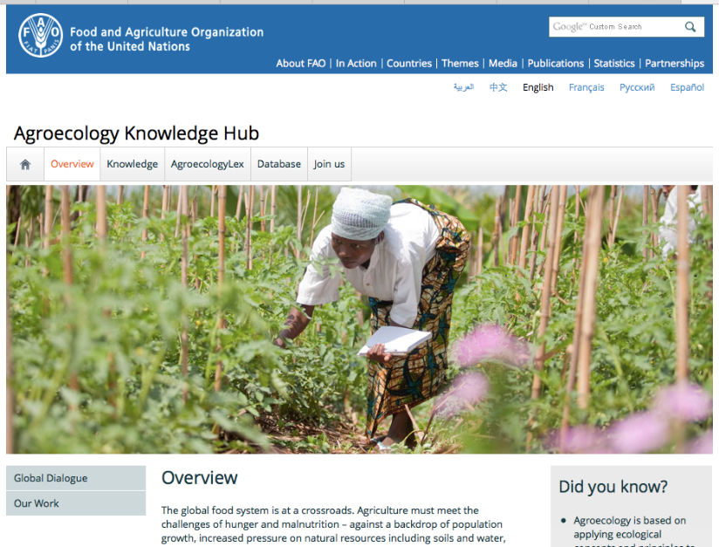
FAO Agroecology knowledge hub
Proceedings and reports of all FAO Seminars and Meetings
Public policies
Scientific publications and articles
Worldwide practices (profiles)
Info available in 6 languages
http://www.fao.org/agroecology/en/

Slide 9
Agroecology for food and nutrition security
Availability: agroecology raises productivity at field level
Access: agroecology reduces rural poverty
Utilization/adequacy: agroecology contributes to improving nutrition
Sustainability/stability: agroecology enhances resilience to external stresses (economic risks, climate change)

Slide 10
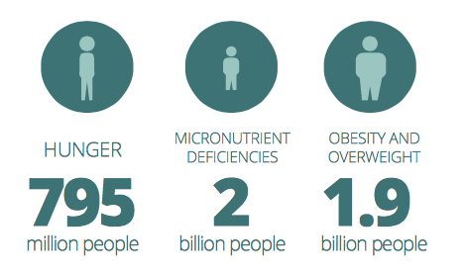
Availability: agroecology raises productivity at field level
Even if key challenges in global food systems
ponder quality over quantity of available food…

Slide 11
Food and ecology – global advocacy
Encyclical “Laudato Si”
“the most extraordinary scientific advances, the most amazing technical abilities, the most astonishing economic growth, unless they are accompanied by authentic social and moral progress, will definitively turn against man”.
December 2010 Report of Special Rapporteur on the Right to Food to UN General Assembly highlights contribution of agroecology to the Right to Food
January 2017 Report of The Special Rapporteur on the Right to Food to UN General Assembly:
  “excessive use of pesticides are very dangerous to human health, to the environment and it is misleading to claim they are vital to ensuring food security”.
  Report highlights developments in agroecology to deliver sufficient yields to feed and nourish the entire world population, without undermining the rights of future generations to adequate food and health.

Slide 12
FAO’s work on agroecology
Through partnerships, inter-sectorial dialogues, knowledge exchange and capacity building, FAO works with the following actors:
Governments and public institutions
Development of public policies and legal frameworks for AE transition
Organizing markets that promote and sustain AE transition
Civil society organizations and producers’ organizations
Systematize and disseminate good practices and field experiences
Facilitate participation in policy dialogues
Evidence base for public policies
Science, Research and Education
Include AE knowledge in official education systems
Promote participatory research and inter-disciplinary scientific knowledge on AE

Slide 13
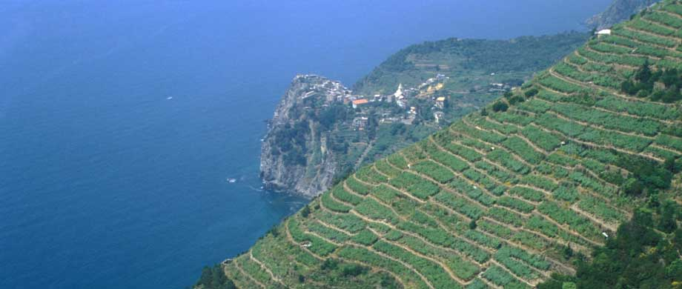
Areas of collaboration
Participation in 2nd Agroecology |Symposium
Information on Agroecology Knowledge hub
Research/studies
Thank you http://www.fao.org/agroecology/en/

